Slide 1



البرنامج التدريبي لتطوير مهارات حديثي التخرج لتعزيز فرص العمل
Data Science and Machine Learning
Module Five: Regression Analysis
Trainer: Dr Ayman Rawshdeh

Slide 2






Data Science and Machine Learning with R
Module 5 – Regression Analysis

Slide 3


Learning Objectives
Explain the meaning and uses of regression analysis
Describe the different types of regression analysis models
List the functions to convert non-linear models to linear models
Discuss R squared and adjusted R squared models
Explain Principal Component Analysis and Factor Analysis of Dimensionality Reduction

Slide 4
Regression Analysis
Topic 1— Introduction to Regression Analysis

Slide 5

Introduction
Consider a scenario where an apparel manufacturing company needs to find out the increase in sales for a particular month based on its TV ad.
The analysis involves finding the relation between the promotion
campaign ad and the sales.

Slide 6

Introduction
In such cases (where a relation between two variables needs to be derived), regression is used. Regression analysis is used to make effective business prediction.

Slide 7
What Is Regression Analysis?
Regression Analysis is a technique used to estimate the relationship between variables and predict the value of one variable (dependent variable) on the basis of other variables (independent variables).

Slide 8
Regression Analysis
Topic 2—Types of Regression Analysis Model

Slide 9
Types of Regression Analysis Models
Simple Regression
Multiple Regression

Slide 10
Types of Regression Analysis Models
Simple Regression
It depicts the relationship between a dependent variable and an independent variable.
It considers one quantitative and independent variable X to predict the other quantitative, but dependent, variable Y.
A straight line is fit to the data.
Multiple Regression

Slide 11
Types of Regression Analysis Models
Simple Regression
It predicts the value of a variable based on the value of two or more other variables.
It considers more than one quantitative and qualitative variable (X₁…X_{N}) to predict a quantitative and dependent variable Y.
Multiple Regression

Slide 12
Types of Regression Analysis Models
Multiple Regression
Simple Regression
Non-Linear Regression
 |  | Polynomial
 |  | Logarithmic
 |  | Square Root
 |  | Reciprocal
 |  | Exponential
Linear Regression
Multiple Regression
Simple Linear
Method of Least Squares
Coefficient of Multiple Determination
Standard Error of the Estimate
Dummy Variable
Interaction

Slide 13
Regression Analysis
Topic 3—Linear Regression

Slide 14
What Is Linear Regression?
Linear regression is a linear approach to modeling the relationship between a scalar response (or dependent variable) and one or more explanatory variables (or independent variables).

Slide 15
Types of Linear Regression
Simple Linear
Method of Least Squares
Coefficient of Multiple Determination
Standard Error of the Estimate
Dummy Variable
Interaction
It depicts the relationship between one dependent and two or
more independent variables.

Slide 16

Types of Linear Regression
Simple Linear
Method of Least Squares
Coefficient of Multiple Determination
Standard Error of the Estimate
Dummy Variable
Interaction
EXAMPLE
Consider the following graph with the equation of the line as shown: Y
x
β₁ represents the slope.
β₁ represents the estimated change in the average value of y as a result of a one- unit change in x.
β₀ represents the estimated average value of y when the value of x is zero.

Slide 17
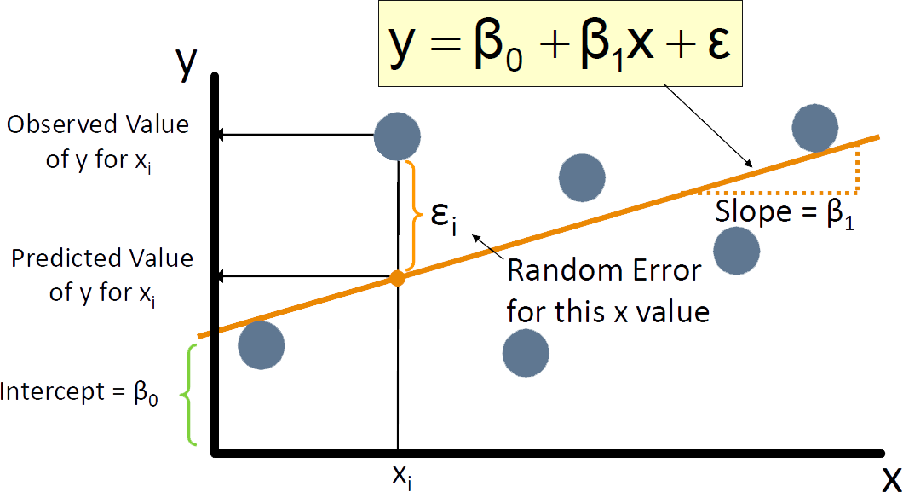
Types of Linear Regression
Simple Linear
Method of Least Squares
Coefficient of Multiple Determination
Standard Error of the Estimate
Dummy Variable
Interaction
EXAMPLE
The values are labeled as shown:

Slide 18
Demo
Perform Simple Linear Regression
Given the class dataset with 5 variables, i.e., name, sex, age, height, and weight representing the information for a class of students, predict the weight based on height.

Slide 19
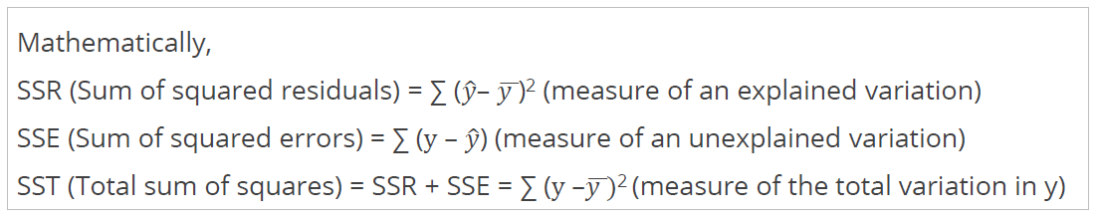
Types of Linear Regression
Simple Linear
Method of Least Squares
Coefficient of Multiple Determination
Standard Error of the Estimate
Dummy Variable
Interaction
Method of least squares identifies the line with the lowest total sum of squared prediction errors (Sum of Squares of Error or SSE).

Slide 20
Types of Linear Regression
Simple Linear
Method of Least Squares
Coefficient of Multiple Determination
Standard Error of the Estimate
Dummy Variable
Interaction
EXAMPLE
Dependent Variable (Y)
Independent Variable (X)
Here, the observations (black) are assumed to be the result of random deviations (orange) from an underlying relationship (blue) between the dependent variable (y) and independent variable (x).

Slide 21
Types of Linear Regression
Simple Linear
Method of Least Squares
Coefficient of Multiple Determination
Standard Error of the Estimate
Dummy Variable
Interaction
Coefficient of multiple determination or R² is ‘Goodness of Fit’ of a regression model that is used to determine the total variance with the help of independent variables.

Slide 22

Types of Linear Regression
Simple Linear
Method of Least Squares
Coefficient of Multiple Determination
Standard Error of the Estimate
Dummy Variable
Interaction
EXAMPLE
Salary
Here, the
SSR ₌ SUM(y_{i}- y_{i}(hat))²
^{y}avg
SST ₌ SUM(y_{i}- y_{avg})²
R² = 1- SS_{res}/SS_{tot}
Experience
Since, SS_{res} > Min ⇒
The value of R² will never decrease

Slide 23
Types of Linear Regression
Simple Linear
Method of Least Squares
Coefficient of Multiple Determination
Standard Error of the Estimate
Dummy Variable
Interaction
ADJUSTED R²
The R² of a model increases with an increase in the number of independent variables.
The adjusted R² penalizes the model, thereby increasing the variables that do not represent the model correctly.
Where,
p = number of regressors N = sample size
R² = 1- SSR/SST
Adj R² = 1- (1-R²)(n-1/n-p-1)

Slide 24
Types of Linear Regression
Simple Linear
Method of Least Squares
Coefficient of Multiple Determination
Standard Error of the Estimate
Dummy Variable
Interaction
Standard error of a regression (Sy.x) is the measure of variability around the line of regression and can be used the same way as standard deviation (SD).
Standard Error = √(𝑺𝑺𝑬/(𝒏−𝒌))
where,
n = Number of observations in the sample k = Total number of variables in the model
Y ± 2 standard errors provide approximately 95% accuracy. However, 3 standard errors provide a 99% confidence interval.

Slide 25
Types of Linear Regression
Simple Linear
Method of Least Squares
Coefficient of Multiple Determination
Standard Error of the Estimate
Dummy Variable
Interaction
A dummy variable includes variables, each with two levels coded 0 and 1.
Assumes that only the intercept is different
Includes slopes that are constant across categories
Permits the use of qualitative data
Incorporates large residuals and influences measures

Slide 26

Types of Linear Regression
Simple Linear
Method of Least Squares
Coefficient of Multiple Determination
Standard Error of the Estimate
Dummy Variable
Interaction
EXAMPLE
Y
Same slopes b₁
Females
b₀
Males
0
X₁
0

Slide 27
Types of Linear Regression
Simple Linear
Method of Least Squares
Coefficient of Multiple Determination
Standard Error of the Estimate
Dummy Variable
Interaction
Assumes the interaction between pairs of X variables
Includes two-way cross-product terms
Can be combined with other models, such as a dummy variable regression model

Slide 28
Types of Linear Regression
Simple Linear
Method of Least Squares
Coefficient of Multiple Determination
Standard Error of the Estimate
Dummy Variable
Interaction
EXAMPLE
Y
Y = 1 + 2X₁ + 3X₂ + 4X₁X₂
Y = 1 + 2X₁ + 3(1) + 4X₁(1) = 4 + 6X₁
12
8
Y = 1 + 2X₁ + 3(0) + 4X₁(0) = 1 + 2X₁
4
0
X₁
0
0.5
1
1.5
In + β₁X_{1i} + β₂X_{2i} + β₃X_{1i}X_{2i}, + ε_{i}without and with the interaction term,
Y_{i} = β₀
the effect of X₁ on Y is measured by 1 and β₁ + β₃X₂, respectively.

Slide 29
Regression Analysis
Topic 4—Non-Linear Regression

Slide 30
What Is Non-Linear Regression?
Nonlinear regression is a form of regression analysis in which observational data is modeled by a function that is a nonlinear combination of the model parameters and depends on one or more independent variables.
It is used when the number of predictors is large. Prior to fitting a regression model with all the predictors, stepwise or best subsets model-selection methods are used. This is done to screen out predictors that are not associated with the responses.

Slide 31
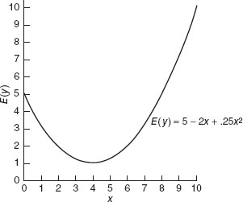
Types of Non-Linear Regression
Polynomial
Logarithmic
Square Root
Reciprocal
Exponential
A Polynomial regression is a form of regression analysis in which the relationship between the independent variable x and the dependent variable y is modeled as an n^{th} degree polynomial in x.
Equation: Y = β₀ + β₁x₁ + β₂x₂ + β₁₁x ² + β x ² + β x x + ε
1 22 2 12 1 2

Slide 32
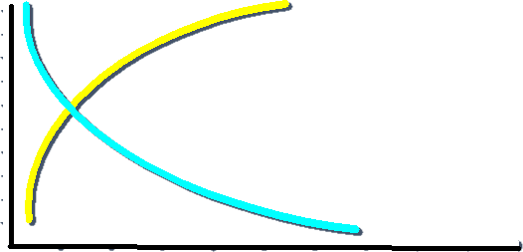
Types of Non-Linear Regression
Polynomial
Logarithmic
Square Root
Reciprocal
Exponential
Logarithmic regression is used to model situations where growth or decay accelerates rapidly at first and then slows over time.
Equation: Y = β₀ + β₁ lnx₁ + β₂ lnx₂ + ε
Y
x₁

Slide 33
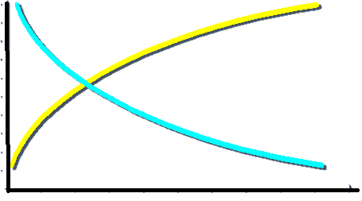
Types of Non-Linear Regression
Polynomial
Logarithmic
Square Root
Reciprocal
Exponential
Square root regression is used to model situations to improve the distribution of the dependent variable.
Equation: Y_{i} = β₀ + β₁ X_{1i} + β₂ X_{2i} + ε_{i}
Y
x₁

Slide 34
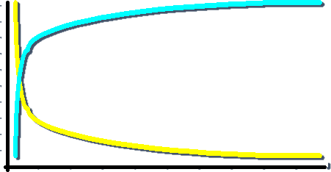
Types of Non-Linear Regression
Polynomial
Logarithmic
Square Root
Reciprocal
Exponential
Reciprocal regression helps in making good predictions for a curved relationship.
Equation: Y = β
1
1
β + β
ε
i 0 1 _{X} 2 _{X}
i
1i
2i
Y
x₁

Slide 35

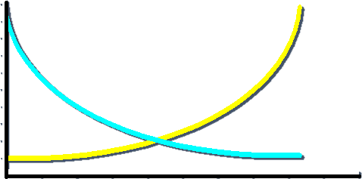
Types of Non-Linear Regression
Polynomial
Logarithmic
Square Root
Reciprocal
Exponential
An exponential regression refers to the process of deriving the equation of the exponential function that fits best for a set of data.
Equation:
Y = e
β₀ +β₁X_{1i} +β X
ε
i
2 2i
i
Y
x₁

Slide 36
Demo
Perform Regression Analysis with Multiple Variables
The buyers of cars are interested in determining the factors that influence the car mileage
Boston dataset consists of variables to predict price of house. Analyze the factors that influence price of house.

Slide 37
Linear Regression Model
LIMITATIONS
While building up the linear regression equation, the following challenges may occur:
The sample of data analyzed for the regression model can be biased.
The model developed may be a good fit for an existing dataset but not for new data.
All data used to train may result in no data for testing.

Slide 38
Linear Regression Model
LIMITATIONS
To overcome such challenges, the concept of cross-validation is used.

Slide 39
Regression Analysis
Topic 5 – Cross-Validation

Slide 40
What Is Cross Validation?
Cross Validation is a technique used to determine the accuracy in predicting models.
In cross validation, the dataset is split into 70:30 (Training data : Testing data) ratio.

Slide 41
Cross Validation: Example
Dataset for Linear Regression Analysis (500 Observations)
Training Dataset (70% of
data – 350 observations)
Test Dataset (30% of data – 150 observations)
Sampling
process
Regression equation
Testing the accuracy of
predictions on Test dataset
K-fold cross validation is the most used cross validation. You will learn it in detail in the next lesson.

Slide 42
Regression Analysis
Topic 6 – Non Linear to Linear Models

Slide 43
Non- Linear Models to Linear Models
Non-linear models can be converted to linear models by applying the following functions:
Exponential
Logarithmic
Trigonometric
Power

Slide 44
Measures of Regression Models
Absolute Percentage Error (APE)
mae<-function(a,b){round(abs(a-b)),2)}
Mean Absolute Error (MAE)
mae<-function(a,b){round(mean(abs(a-b)),2)}
Mean Absolute Percentage Error/Deviation (MAPE/MAPD)
mape<-function(a,b){round(mean(abs(a-b)/a),4)}
Root Mean Squared Error (RMSE)
rmse<-function(c,d){round(sqrt(mean((c-d)^2)),2)}

Slide 45


Key Takeaways
Regression analysis is used to estimate the relationship between variables.
Simple regression considers one quantitative and independent variable X to predict
the other quantitative, but dependent, variable Y.
Multiple regression considers more than one quantitative and qualitative variable (X₁…X_{N}) to predict a quantitative and dependent variable Y.
R squared and adjusted R squared are important measures of a regression model and explain the variance with the help of independent variables.
Factor analysis and principal component analysis are the methods used to decrease the number of variables or factors in a model.
Multiple regression has two types of models; linear and non-linear

Slide 46
This concludes “ Linear Regression .”
The next lesson is “Classification.”

